Slide 1
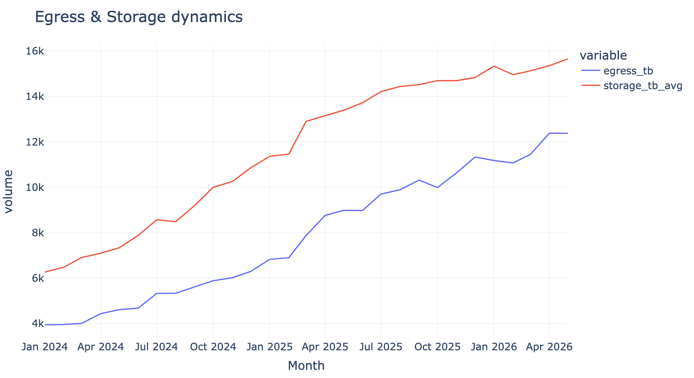
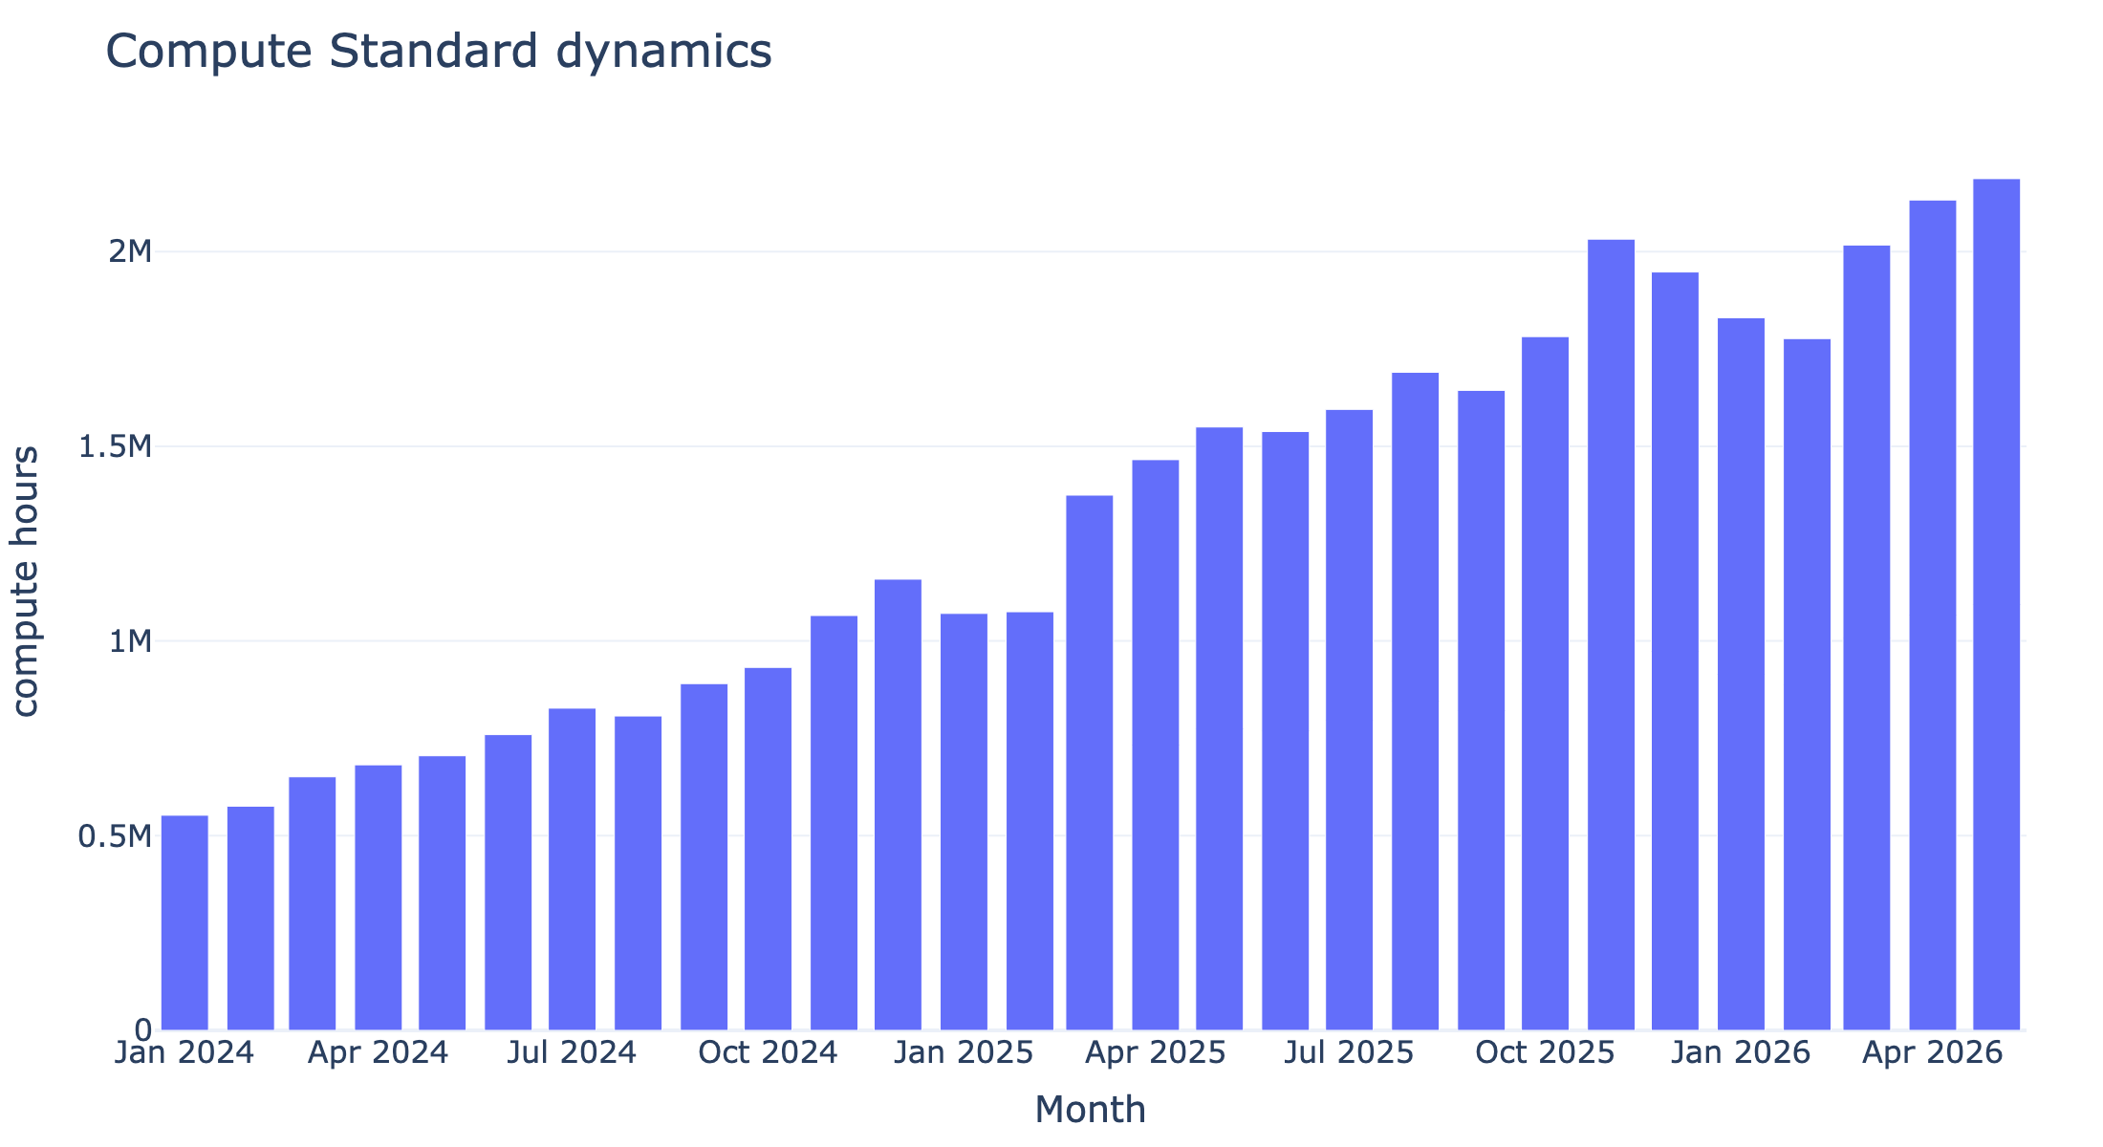
NimbusCompute
Data Research
Exploratory findings that drive the consumption and cash forecast
Forecast window: June–August 2026 · as-of date: 2026-06-06
NimbusCompute data research · 1

Slide 2
What we explored
Source tables, data risks, and forecast implications
Area | Main question | Forecast impact
Business events | Which known events distort historical patterns? | Price, product migration, billing change, sales-policy changes
monthly_usage | What is the cleanest measure of customer consumption? | Primary basis for organic consumption forecast
contracts + customers | Which customers are active and what terms apply? | Discounts, payment terms, churn treatment
CRM pipeline | Which future deals should be added? | Scenario-specific new consumption and prepayments
invoices | What cash is already receivable? | Existing AR and payment timing model
Conclusion: monthly_usage is the most reliable table for consumption; invoices are used for cash timing, not for rebuilding product usage.
NimbusCompute data research · 2

Slide 3
Business events that affect the data
These events define how historical patterns should be read
Date | Event | Product | Interpretation
Jul-2025 | pricing_change | compute_standard | Compute list price reduced for new and renewing contracts.
Oct-2025 | product_migration | gpu_a100 | Legacy GPU SKU migrated to gpu_accelerated in usage telemetry.
Mar-2026 | capacity_constraint | gpu_accelerated | Temporary GPU supply constraint delayed some enterprise ramps.
Apr-2026 | billing_system_change | — | Invoice export switched source; Finance flagged duplicate risk.
May-2026 | sales_policy | — | Saving-plan packages split into component opportunities for visibility.
Forecast implication
• merge legacy and new GPU SKUs for trend analysis
• treat March 2026 as distorted for GPU growth
• check CRM opportunities for double-counting after May policy change
NimbusCompute data research · 3

Slide 4
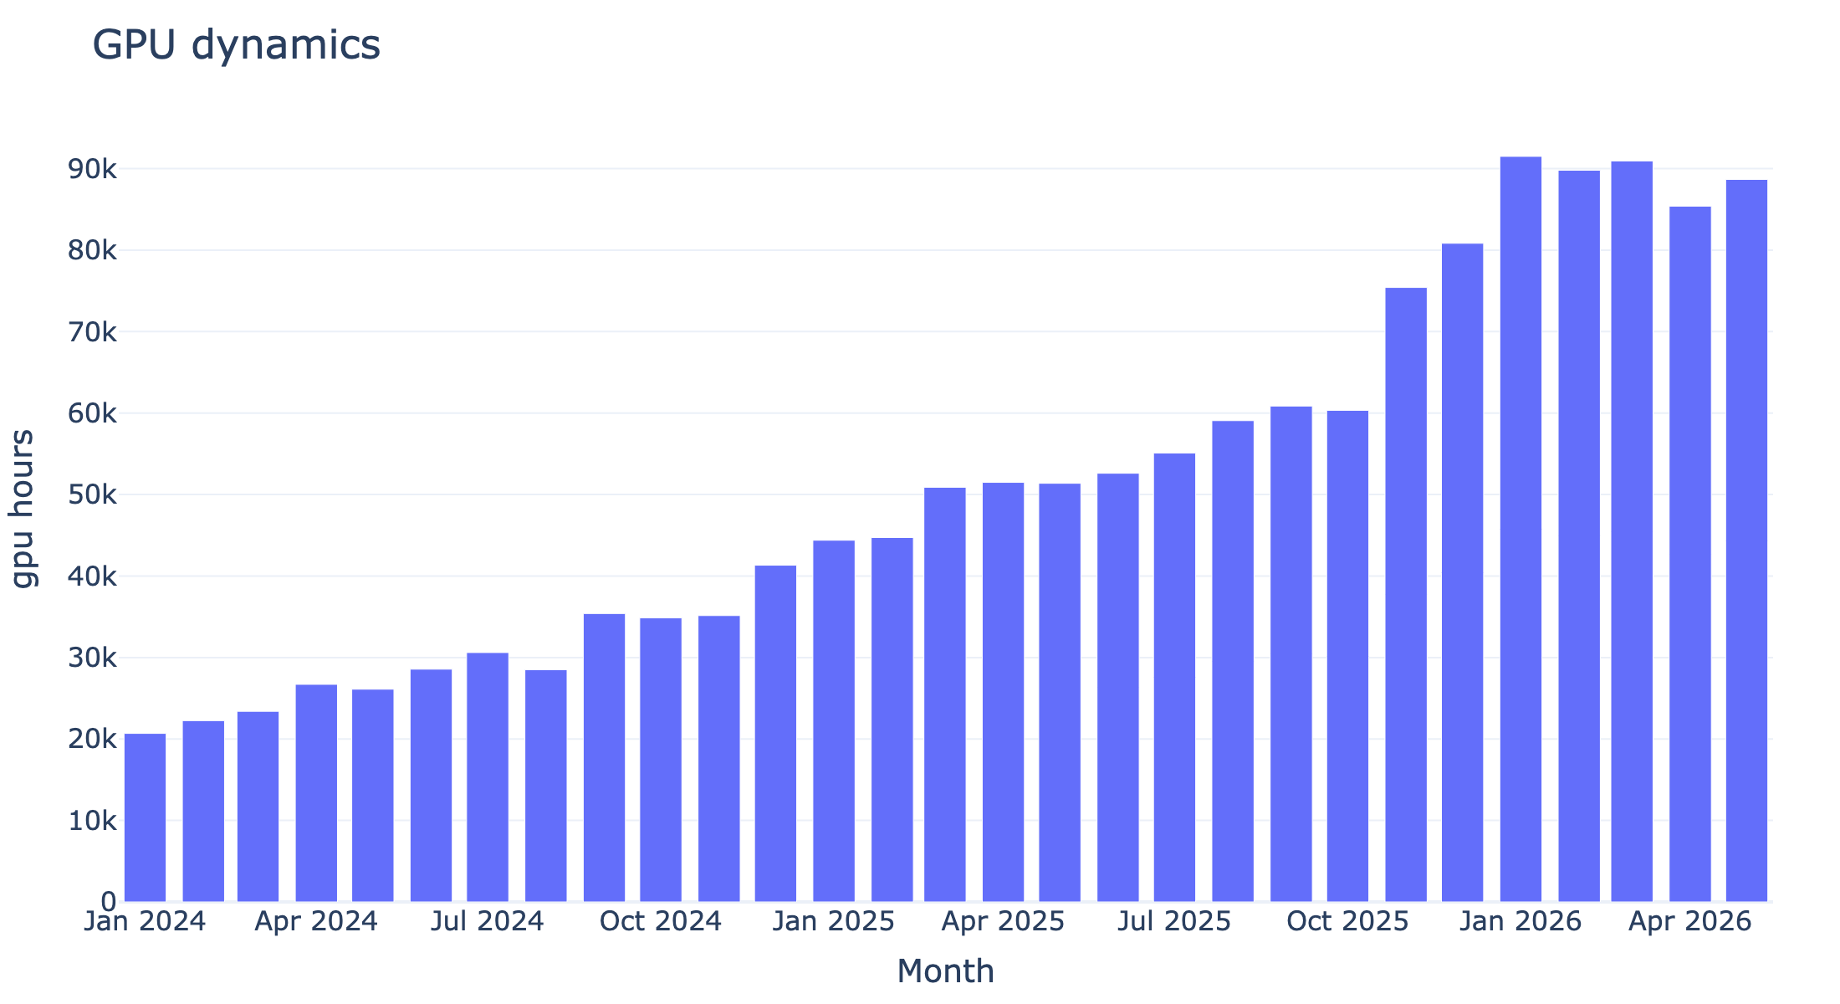
Usage grows materially; compute remains the backbone
Native units are shown to illustrate volume shape and product mix
Compute shows a smooth upward trend and is the most stable anchor for the forecast.
GPU accelerates sharply from late 2025, but the jump is recent and concentrated; extrapolate cautiously.
• all products grow year over year
• seasonality exists but is weak and unstable
• recent product mix is more informative than full-history averages
NimbusCompute data research · 4

Slide 5
Compute standard: stable upward trend
The largest and most predictable component of current usage
• compute_standard is the backbone of the active customer base
• growth is relatively consistent with no single structural break
• May 2026 is a reasonable anchor for near-term organic forecast
• price change in Jul-2025 is handled through price and contract logic
Forecast treatment: product-level coefficients for most customers; selected large customers forecast separately.
NimbusCompute data research · 5

Slide 6
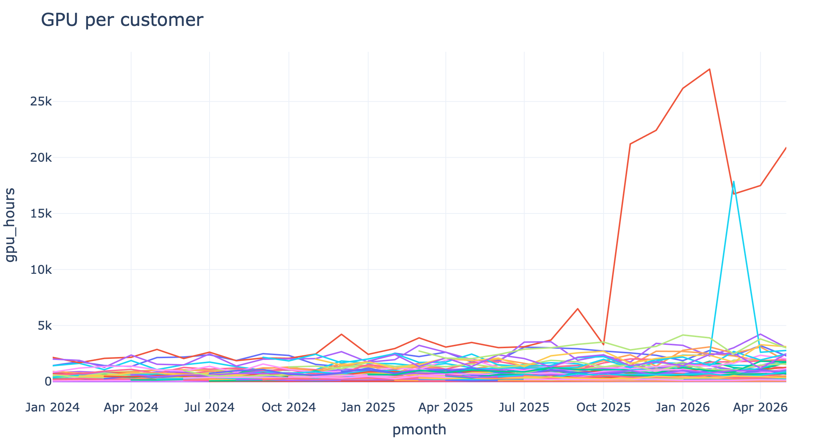
GPU: sharp take-off with concentrated drivers
Legacy gpu_a100 and gpu_accelerated are merged for trend analysis
The aggregate jump begins after the Oct-2025 product migration and is affected by Mar-2026 capacity constraints.
Customer-level view shows concentration and outliers. This is why naive extrapolation overstates GPU growth.
NimbusCompute data research · 6

Slide 7
Storage and egress: smooth expansion
Stable contributors with lower volatility than GPU
• object_storage and network_egress both grow steadily
• no abrupt breaks similar to GPU migration
• good candidates for product-level trend extrapolation
• object_storage price change applies broadly from Jan-2026
Forecast treatment: product-level coefficients are appropriate for most customers.
NimbusCompute data research · 7

Slide 8
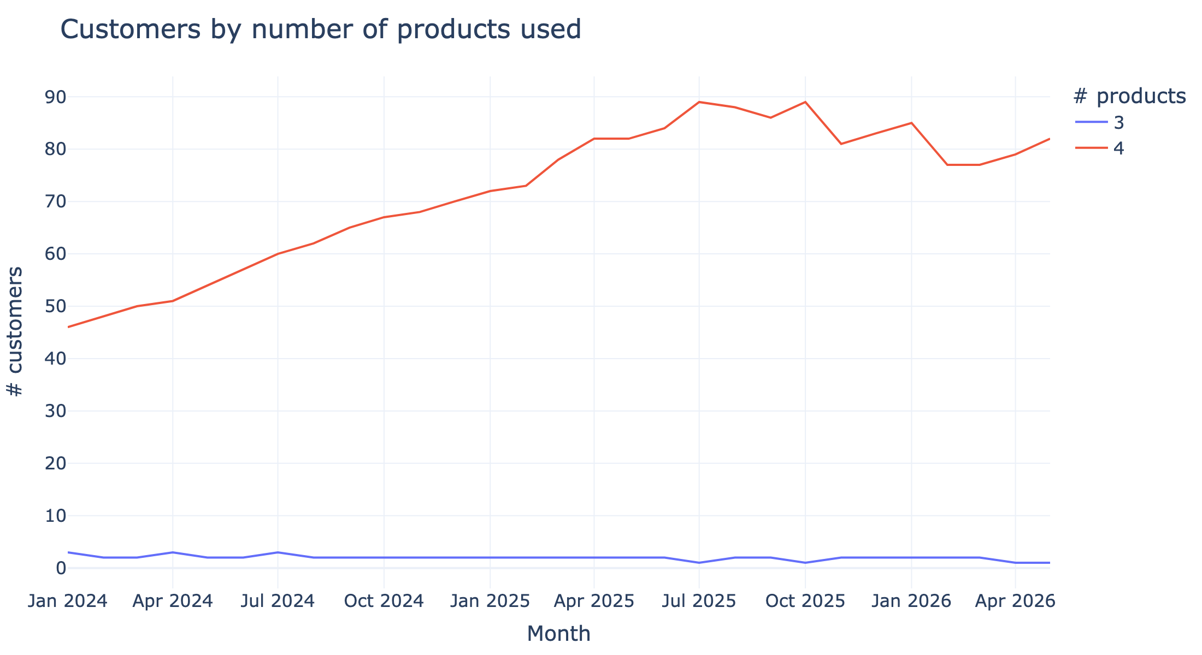
Product adoption: most active customers use all four products
Useful for checking whether missing product usage is normal or anomalous
• most customers use all 4 products
• a small group uses only 3 of 4, usually missing GPU
• customer count grows until mid-2025, then dips and recovers
• forecast should not revive product usage for customers without May activity
NimbusCompute data research · 8

Slide 9
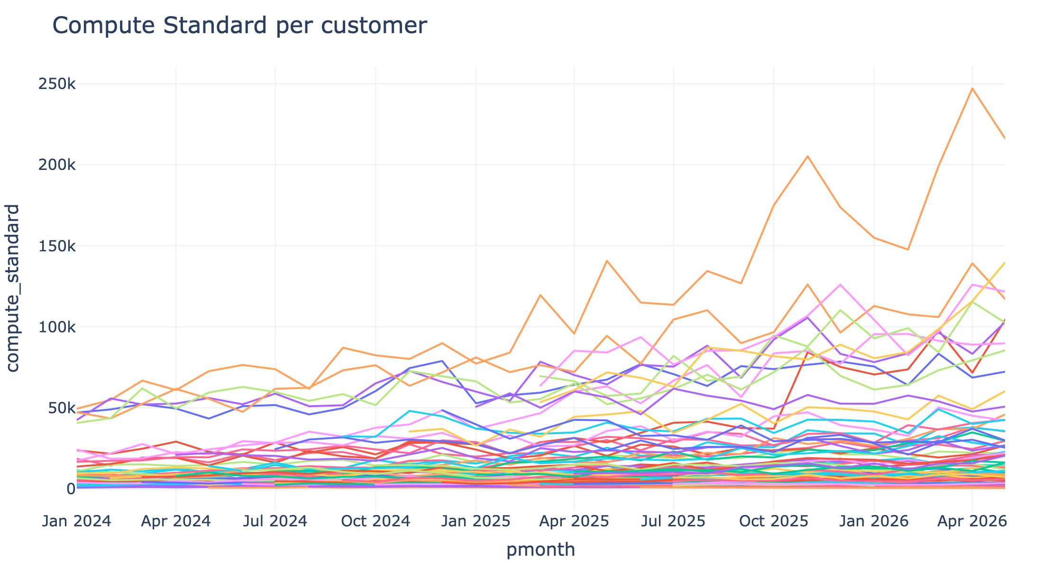
A few partners dominate usage
Concentration motivates customer-specific handling for the largest accounts
• large partners should not be treated as small noisy accounts
• selected large accounts use customer-level coefficients
• remaining base uses product-level coefficients to reduce volatility
NimbusCompute data research · 9

Slide 10
Customer status: primary churn signal
Status is used to define the active organic customer base
Status | Last usage month | Customers | Forecast treatment
active | 2026-05-01 | 79 | Included in organic forecast
churned | 2025-10-01 | 1 | Excluded from organic forecast
churned | 2026-01-01 | 1 | Excluded from organic forecast
churned | 2026-02-01 | 1 | Excluded from organic forecast
churned | 2026-05-01 | 4 | Contributes to May actuals, not to forward organic base
paused | 2026-01-01 | 4 | Excluded from organic forecast
Important nuance: status is the primary signal, not a perfect truth source. The 4 churned customers with May usage should be validated, but are excluded from forward organic forecast in the current model.
NimbusCompute data research · 10

Slide 11
CRM ambiguity: Vertex Labs overlapping opportunities
Current model uses scenario-based handling rather than adding all records
Opp | Stage | Monthly | Committed | Model treatment
OPP-1035 | Commit | $410K | $8.2M | Not added separately to avoid double counting
OPP-1036 | Commit | $230K | $4.6M | Included in Base as selected compute component
OPP-1037 | Commit | $690K | $13.8M | Included in Upside as full umbrella agreement
• 410K + 230K = 640K, while umbrella record is 690K: related but not a clean sum
• Base and Upside intentionally encode different deal-scope assumptions
• Sales validation is required before treating the full umbrella as committed
Forecast rule: Downside includes OPP-1039 only; Base includes OPP-1039 + OPP-1036; Upside includes OPP-1039 + OPP-1037.
NimbusCompute data research · 11

Slide 12
Invoices feed the cash forecast, not consumption volume
Cash model is built point-in-time as of 2026-06-06
• issued and unpaid invoices reconstruct existing AR as of the forecast date
• near-term AR is scheduled using due date + 7 days
• overdue AR is handled with aging recovery assumptions
• future postpaid usage uses historical payment timing among paid invoices
• void_pending and test invoice risk are excluded from cash basis where applicable
Data implication: consumption forecast starts from usage; cash forecast starts from invoices, AR state, payment lag, and opportunity prepayments.
NimbusCompute data research · 12

Slide 13
Key takeaways for the forecast
How the data research maps into the final model
Finding | Forecast implication
monthly_usage is the cleanest consumption source | Use it as the basis for organic consumption forecast
large customers dominate product usage | Model selected large customers individually; use product-level trend for others
GPU growth is concentrated and recent | Cap coefficients and avoid naive customer-level extrapolation
billing_customers status is the primary churn signal | Active customers form the organic base; churned/paused are excluded
CRM contains overlapping Vertex records | Use scenario-based treatment and validate deal structure with Sales
invoices reflect cash timing and AR state | Separate consumption forecast from cash collections forecast
Open questions: validate Vertex structure with Sales, confirm treatment of churned customers with May usage, and review large overdue receivables for cash planning.
NimbusCompute data research · 13

